Slide 1
Modeling INDRA networks for causal inference

Slide 2
Problem
Many resources for building causal networks
INDRA
Causal discovery algorithms
Data
All have some issues
Can we leverage all these options and use them together?
Notes:
INDRA
Cycles
Confounders that are not real
Edges that are not real
CD Algs
Wrong
Slow
Data
No directionality

Slide 3
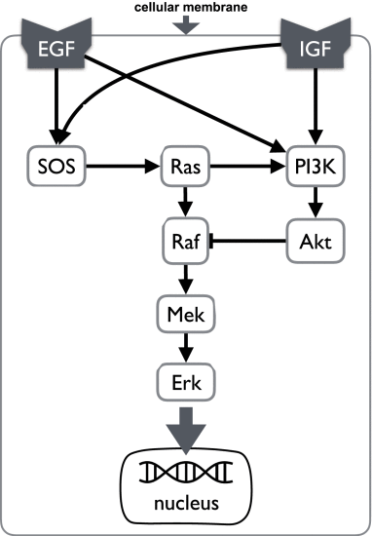
Can we reconstruct a IGF/EGF signalling DAG?

Slide 4


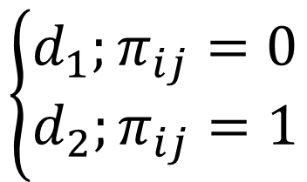
Modelling strategy – Differentiate between real and “fake” edges
$$p_{ij}=Beta(1,1)$$
$$π_{ij}=Bernoulli(p_{ij})$$
$$\left\{\begin{aligned}d_{1};π_{ij}=0 \\ d_{2};π_{ij}=1\end{aligned}\right.$$
There are def other ways to do this (clustering)

Slide 5
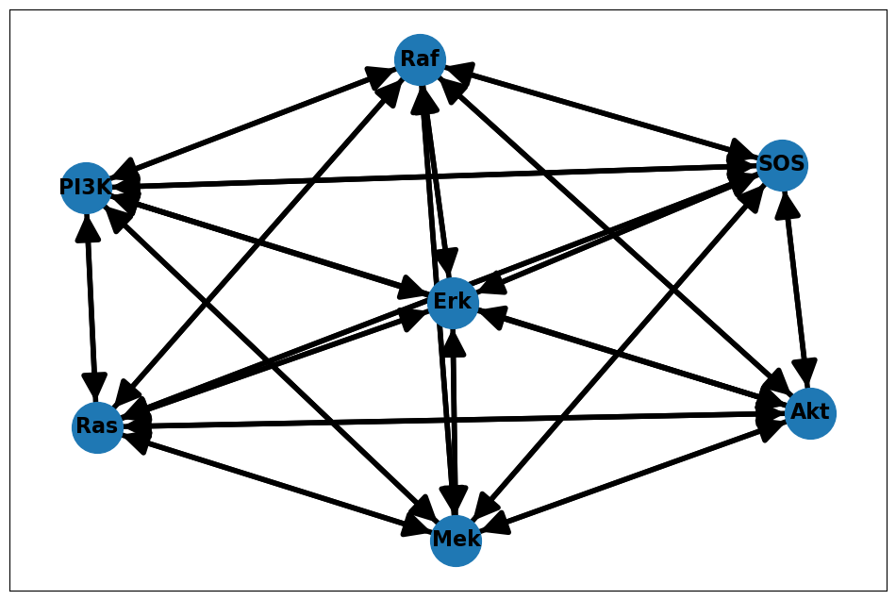

Start with some data -
$$P(π_{ij}|D)$$
Potential edges
Simulate proteomics data with missing values and such given real network
Calculate correlations between nodes
No confounders
Going to be wrong but gives a good baseline of the model workflow

Slide 6
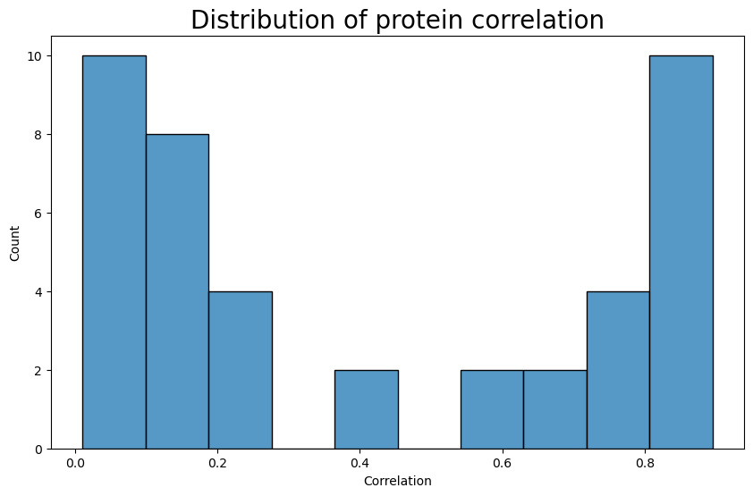
Correlation between nodes

Slide 7
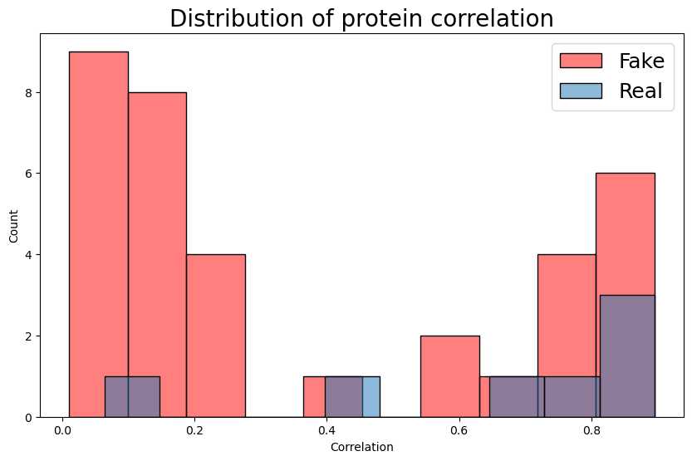
Correlation between nodes
Specify correlation distributions as Log Normals

Slide 8
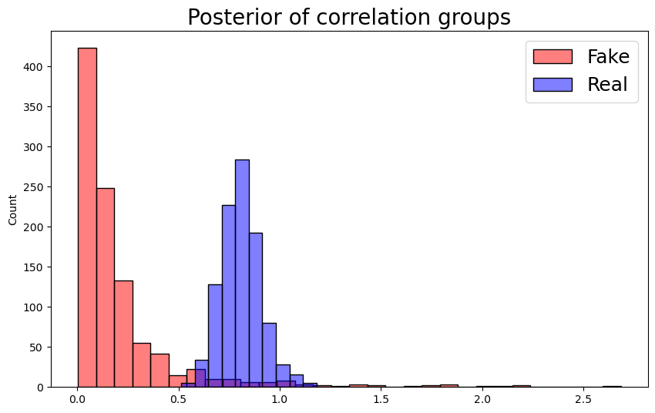
Posterior correlation distributions

Slide 9
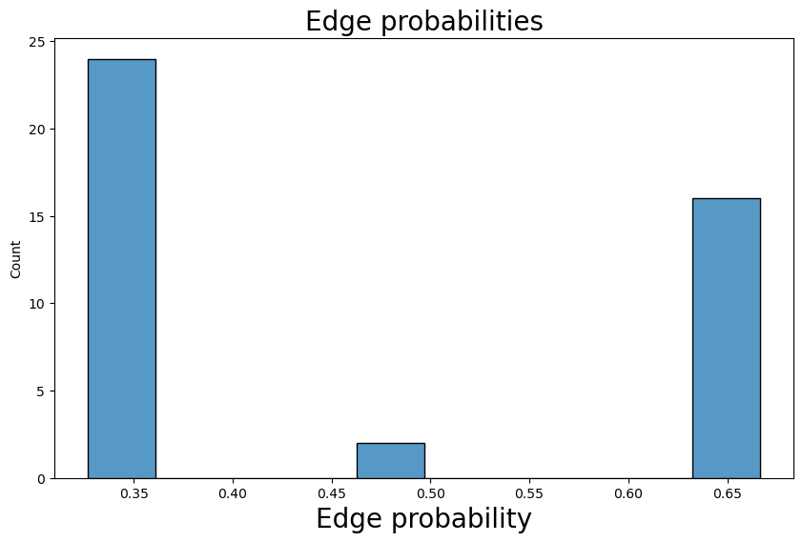
Edge probabilities in three groups

Slide 10
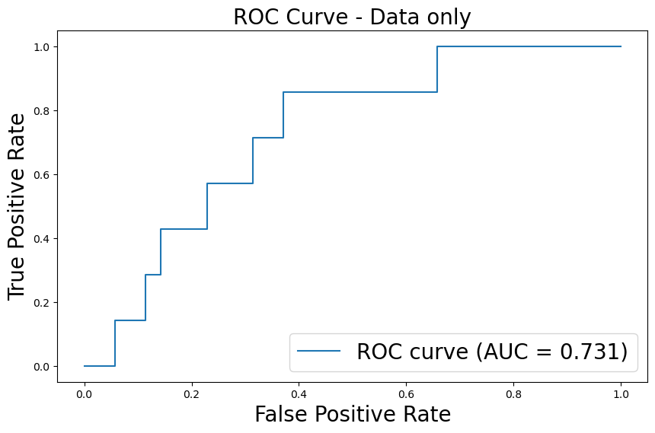
ROC curve

Slide 11
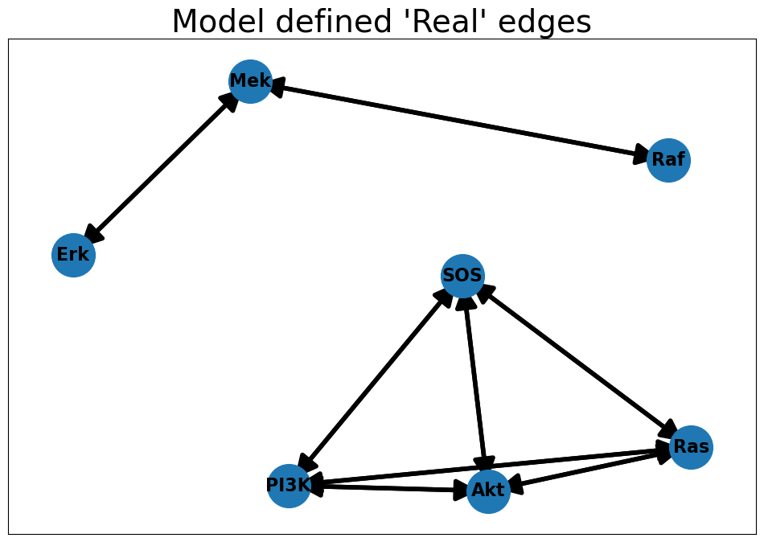
Is the graph correct?

Slide 12

Incorporate INDRA edges -
$$P(π_{ij}|INDRA)$$
Advantages of INDRA
Constrain the edges we are looking at
Directionality
Incorporate latent nodes
Disadvantages
Potentially unreal edges

Slide 13
What does real INDRA data look like
Extract networks of gene sets
“Human” only
Increase/decrease events
Direct connections, 1-node mediated connections, and confounders
Model the “evidence” for an edge

Slide 14
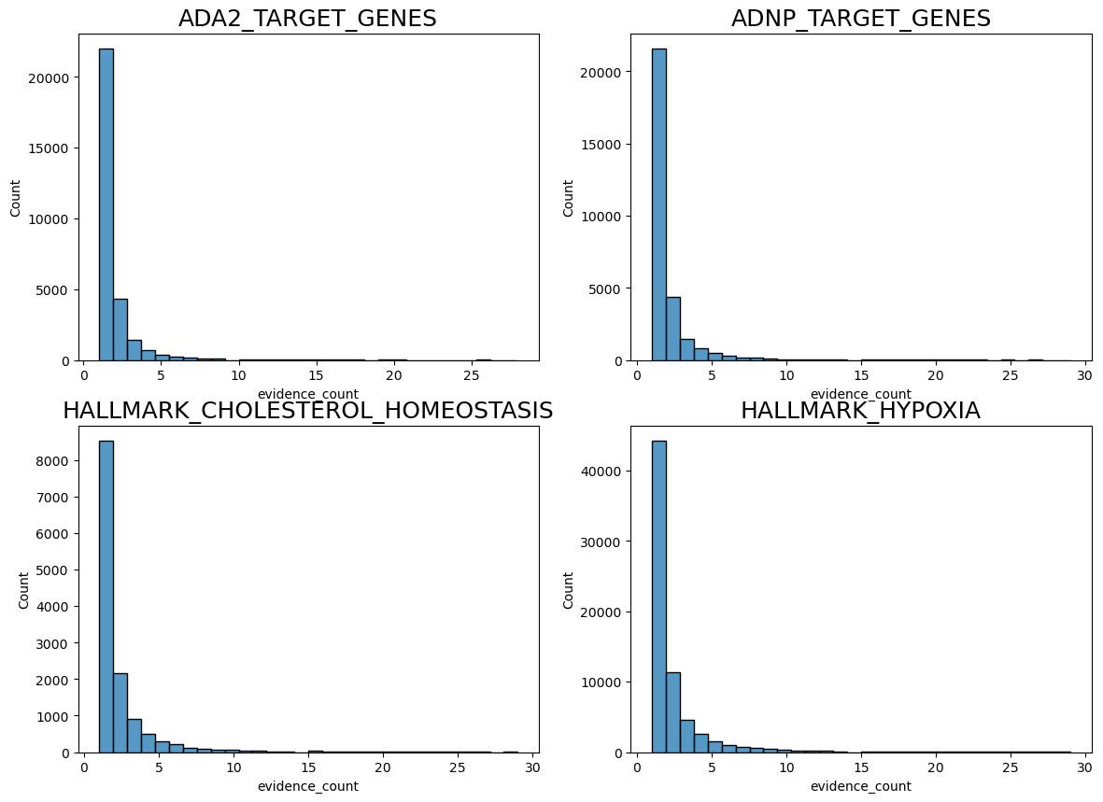
Example distributions (filtered <30)

Slide 15
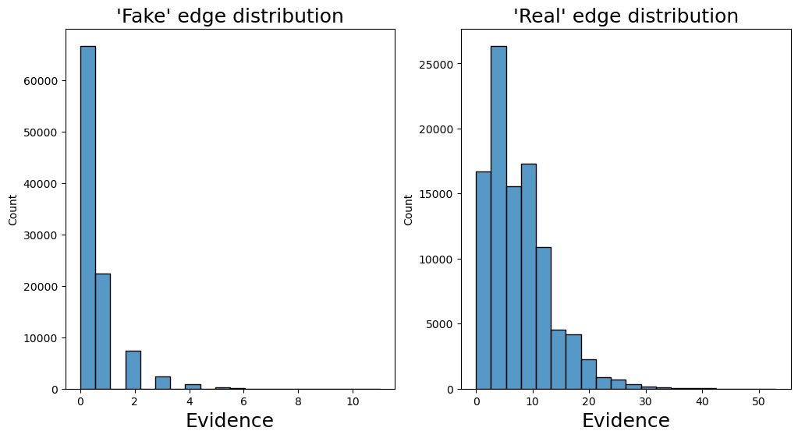
Assume Negative Binomial / Gamma Poisson distributions

Slide 16
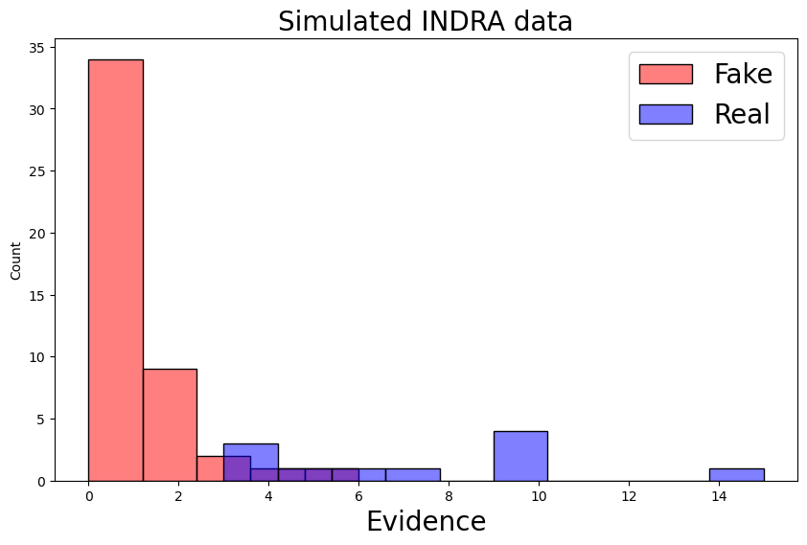
Simulated data

Slide 17
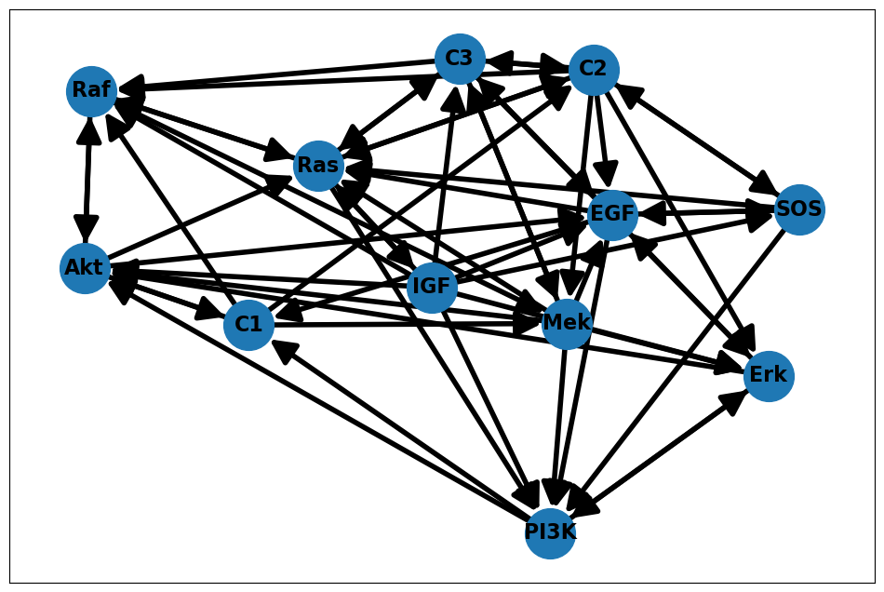
Simulated INDRA network

Slide 18
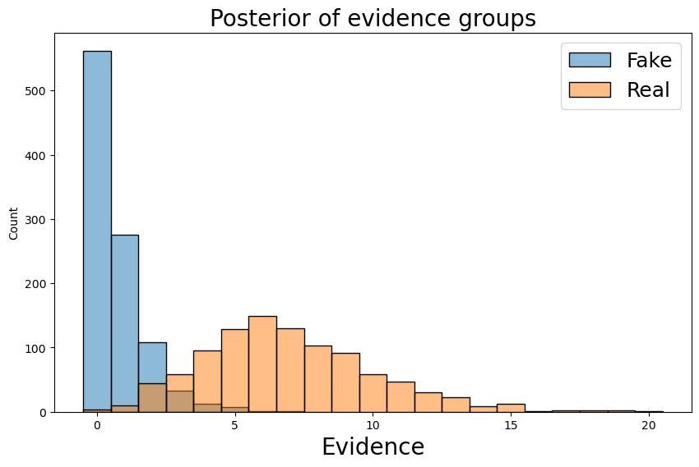
Train model

Slide 19
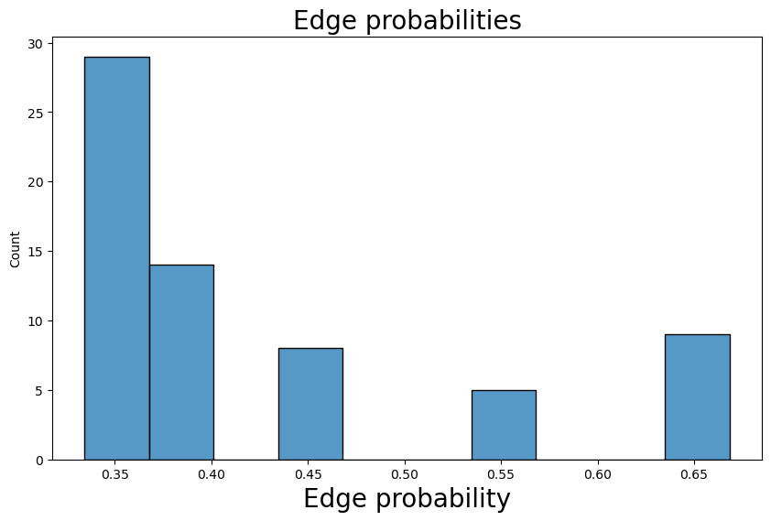
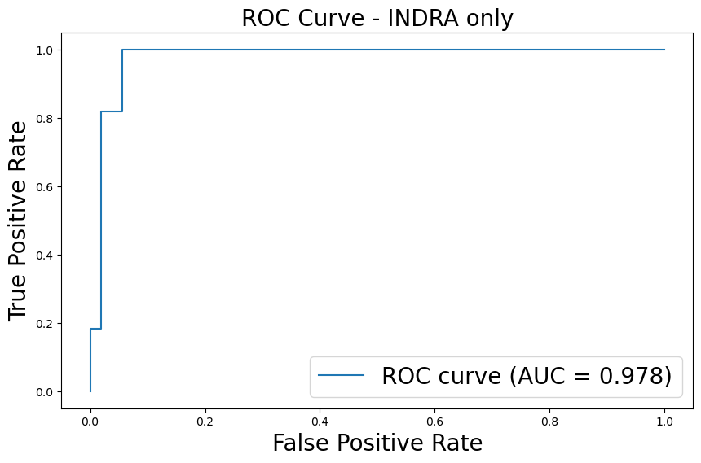
Model results

Slide 20
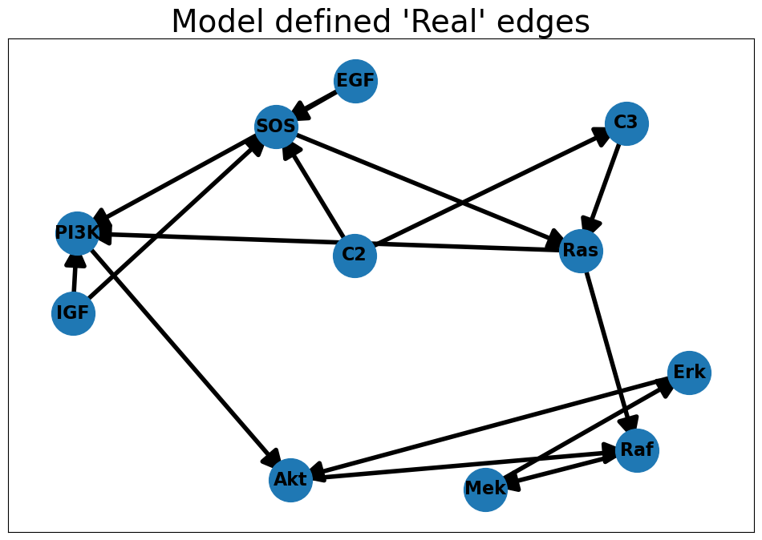
Is the graph correct?

Slide 21
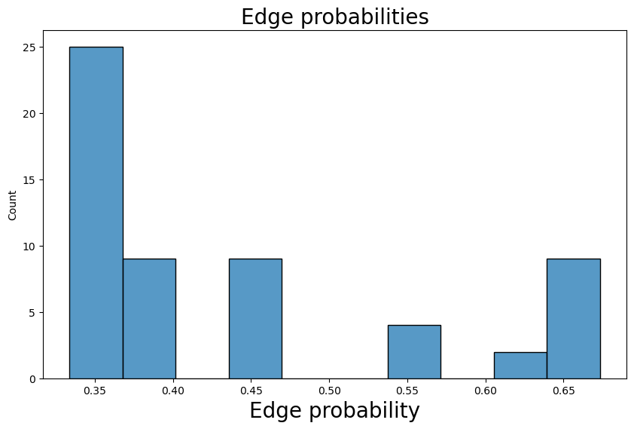
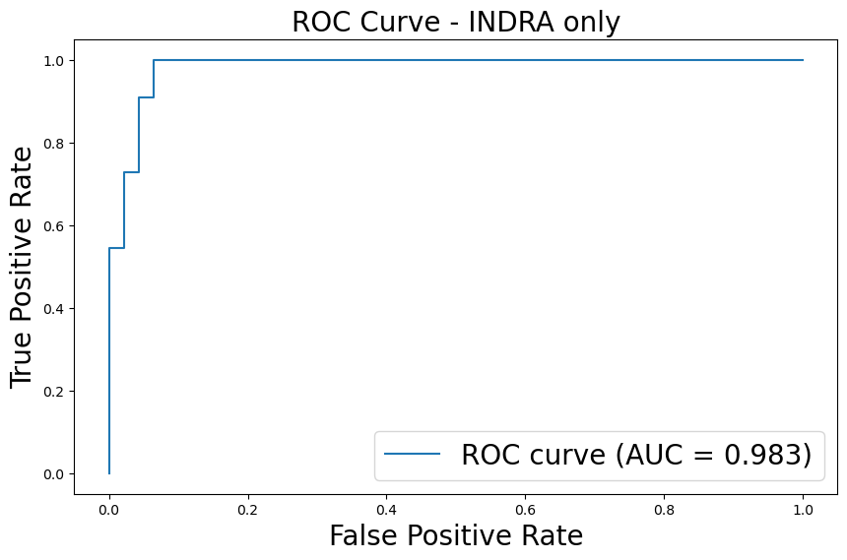

Combine INDRA and data -
$$P(π_{ij}|INDRA, D)$$

Slide 22
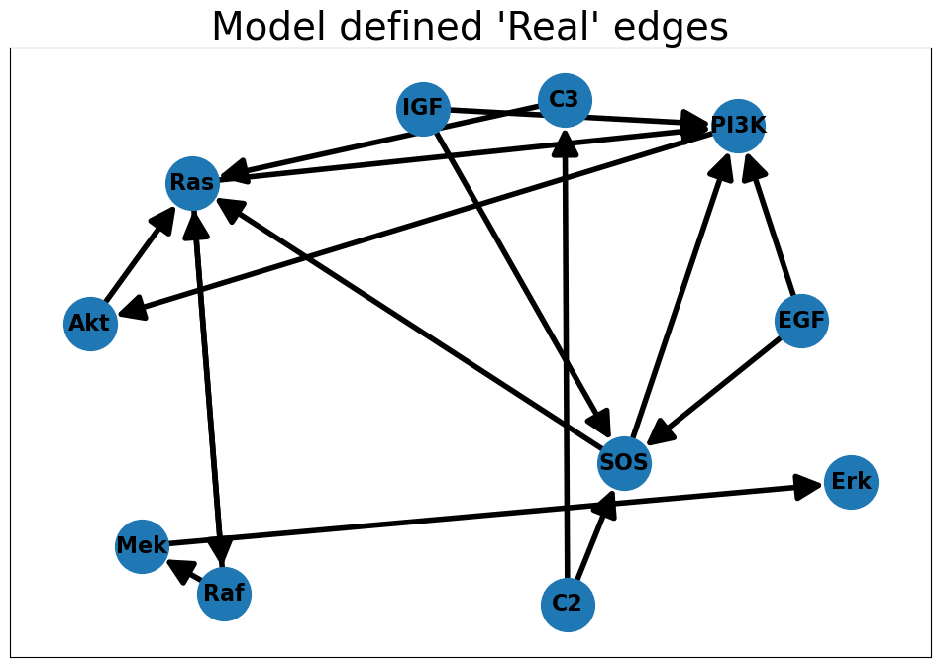
Is the graph correct?

Slide 23

Directionality based weighting -
$$P(π_{ij}|INDRA, D_{w})$$
INDRA can show evidence for I => J and J => I
Data will confirm both edges are true
Generally, one of these edges will have more evidence
Weigh the edge with more evidence
Define weights as scaled differences between bi-directed edges

Slide 24
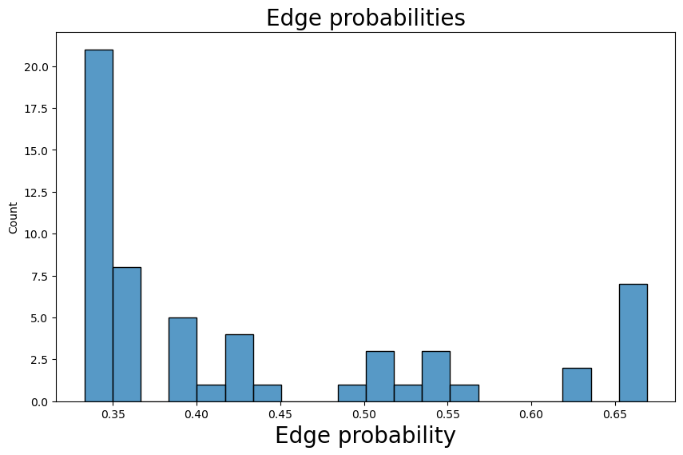
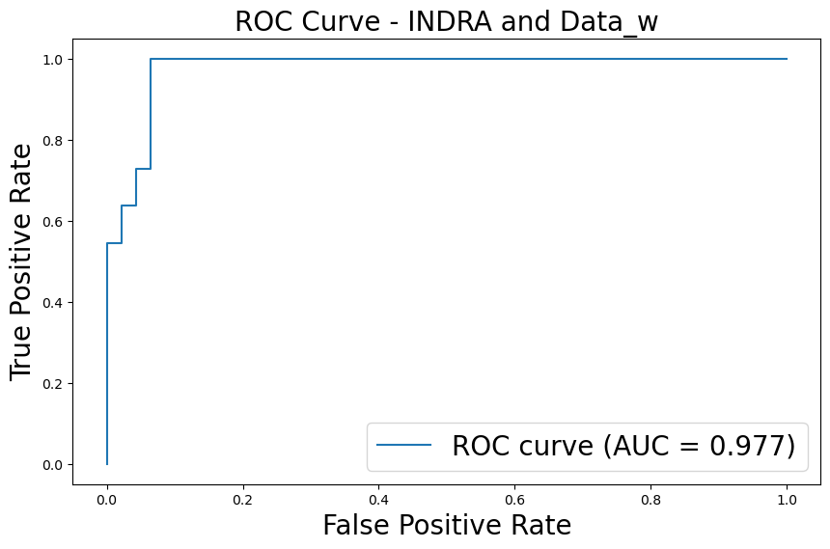
Model Results

Slide 25
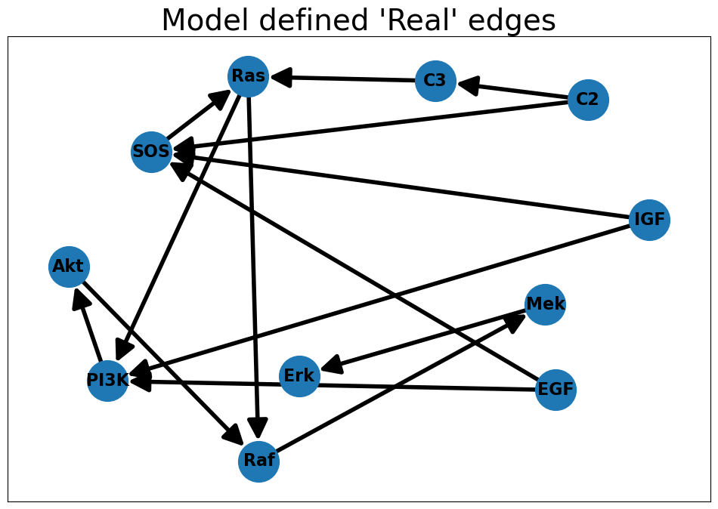
Is the graph correct?

Slide 26
Next steps
Include conditional independence information to help ID what confounders are there
Can we include the results of causal discovery? Reusing data a bunch
Further validation of low probability edges using interventional data

